Slide 1
Joint probability

Slide 2
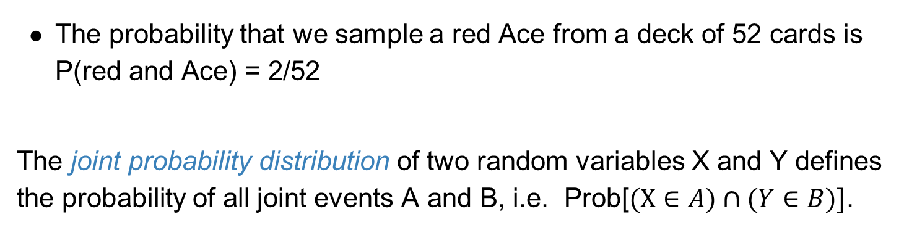
Joint probabilities
The probability of the joint outcomes of two or more random events (or processes) is called a joint probability.
The probability that we sample a red Ace from a deck of 52 cards is P(red and Ace) = 2/52
The joint probability distribution of two random variables X and Y defines the probability of all joint events A and B, i.e. Prob[$(X∈A)∩(Y∈B)]$.

Slide 3
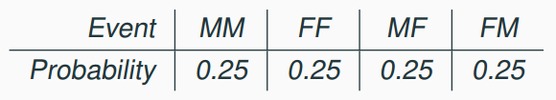
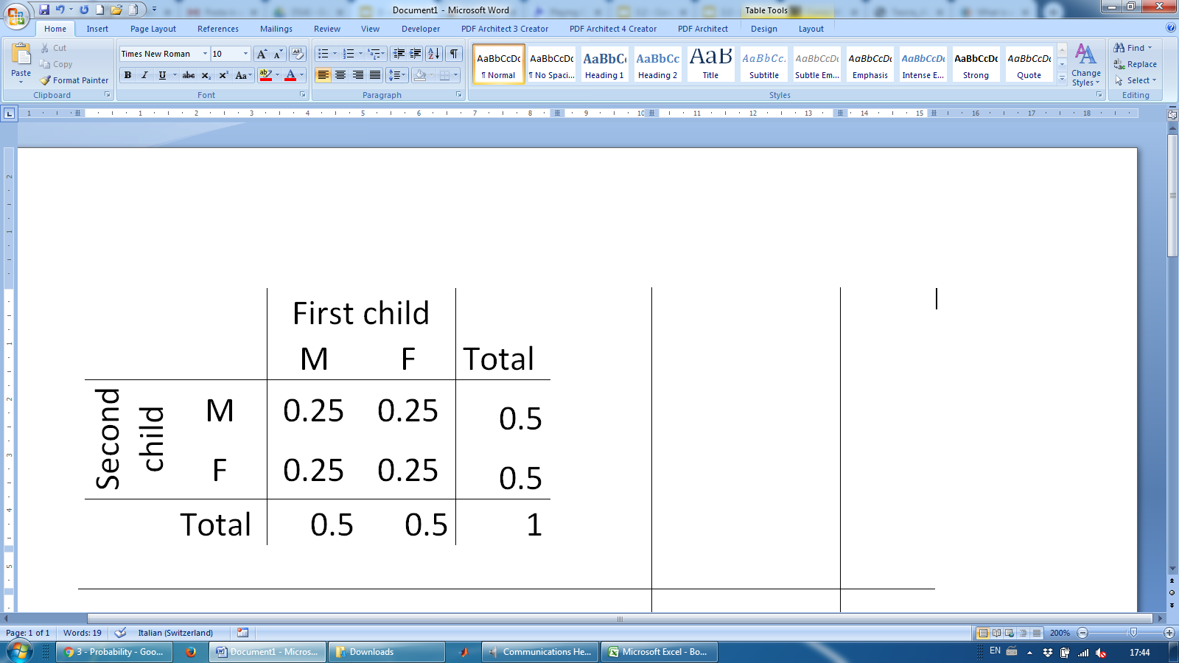
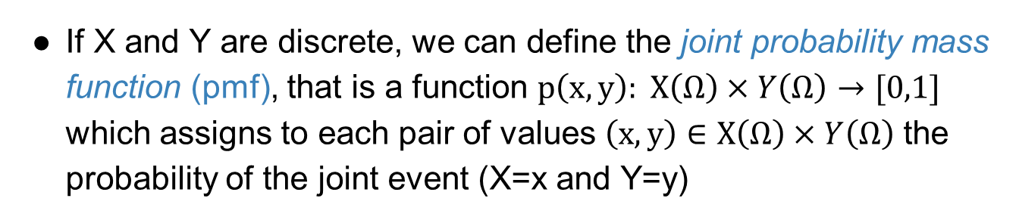
Joint probability mass function
If X and Y are discrete, we can define the joint probability mass function (pmf), that is a function $p\left(x,y\right): X\left(Ω\right)×Y\left(Ω\right)→[0,1]$ which assigns to each pair of values $\left(x,y\right)∈X\left(Ω\right)×Y\left(Ω\right)$ the probability of the joint event (X=x and Y=y)
The probability distribution for the genders of two children is a joint probability
It can be described it by a two-way probability table

Slide 4
Marginal probabilities
The column Total shows the probability of having a male or female as second child, independently of the sex of the first child
The row Total shows the probability of having a male or female as first child, independently of the sex of the second child
These are called marginal probabilities as they refer to a single random event

Slide 5
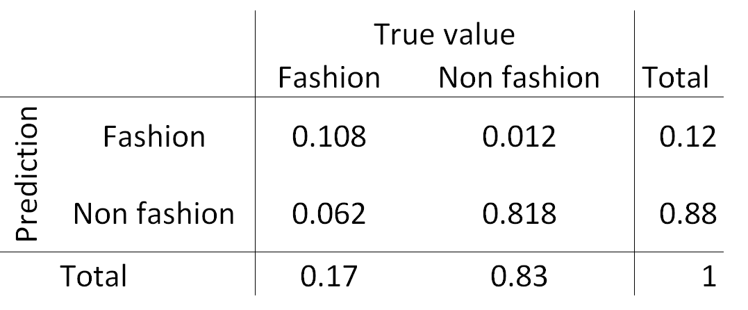
Practice
What is the (marginal) probability that a photo is about fashion?

Slide 6
Practice
What is the (marginal) probability that a photo is about fashion?

Slide 7
Practice
What is the joint probability that a photo is about fashion and the classifier predicts it correctly?

Slide 8
Practice
What is the joint probability that a photo is about fashion and the classifier predicts it correctly?

Slide 9
Independent random variables
Notice that each joint probability in the table can be obtained as the product of the corresponding marginal probabilities.
This is because the variables “sex of the first child” and “ sex of the second child” are independent.

Slide 10
Independent random variables
We consider a classifier trained to distinguish between fashion and non-fashion photos. The variables of interest are the true type of the photo and the prediction of the algorithm.
Are the two variables independent?

Slide 11
Independent random variables
We consider a classifier trained to distinguish between fashion and non-fashion photos. The variables of interest are the true type of the photo and the prediction of the algorithm.
Are the two variables independent? NO
≠ 0.17・0.12
≠ 0.83・0.12
≠ 0.17・0.88
≠ 0.83・0.88

Slide 12
Conditional
Probability

Slide 13
Conditional probability
What is the probability that the classifier predict a photo correctly when the photo is about fashion?

Slide 14
Conditional probability
What is the probability that the classifier predict a photo correctly when the photo is about fashion?
We know the photo is fashion, so the probability of the event True value = Non fashion is now 0.

Slide 15
Conditional probability
What is the probability that the classifier predict a photo correctly when the photo is about fashion?
We know the photo is fashion, so the probability of the event True value = Non fashion is now 0.
0
0.635
=0.635
0.17
0
=0.365
0.365
0.17
0
=1
0.17

Slide 16

Conditional probability
The conditional probability of the outcome of interest A given condition B is calculated as

Slide 17

Conditional probability
The conditional probability of the outcome of interest A given condition B is calculated as
For instance:

Slide 18
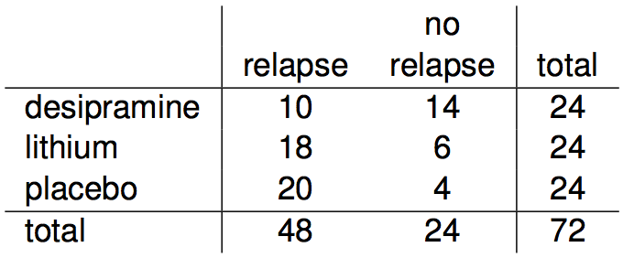
Conditional probability (cont.)
Assume to randomly sample a patient from the set of patients in the table below.
If we know that a patient received the antidepressant (desipramine), what is the probability that they relapsed?

Slide 19
Conditional probability (cont.)
Assume to randomly sample a patient from the set of patients in the table below.
If we know that a patient received the antidepressant (desipramine), what is the probability that he/she relapsed?
P(relapse | desipramine) = 10 / 24 ~ 0.42

Slide 20
Conditional probability (cont.)
If we know that a patient relapsed, what is the probability that he/she received the antidepressant (desipramine)?

Slide 21
Conditional probability (cont.)
If we know that a patient relapsed, what is the probability that they received the antidepressant (desipramine)?
P(desipramine | relapse) = 10 / 48 ~ 0.21

Slide 22
Conditional probability (cont.)
If we know that a patient relapsed, what is the probability that they received the antidepressant (desipramine)?
P(desipramine | relapse) = 10 / 48 = 0.21
P(lithium | relapse) = 18 / 48 = 0.38
P(placebo | relapse) = 20 / 48 = 0.42

Slide 23
Factorization and law of total probability

Slide 24
General multiplication rule
Earlier we saw that if two events are independent, their joint probability is simply the product of their probabilities. If the events are not believed to be independent, the joint probability is calculated slightly differently.

Slide 25
General multiplication rule
Earlier we saw that if two events are independent, their joint probability is simply the product of their probabilities. If the events are not believed to be independent, the joint probability is calculated slightly differently.
If A and B represent two outcomes or events, then P(A and B) = P(A | B) P(B) This is called factorization of P(A and B)
Note that this formula is simply the conditional probability formula, rearranged.

Slide 26
General multiplication rule
Earlier we saw that if two events are independent, their joint probability is simply the product of their probabilities. If the events are not believed to be independent, the joint probability is calculated slightly differently.
If A and B represent two outcomes or events, then P(A and B) = P(A | B) P(B) This is called factorization of P(A and B)
Note that this formula is simply the conditional probability formula, rearranged.
P(A and B) can also be factorized as P(B | A) P(A)

Slide 27
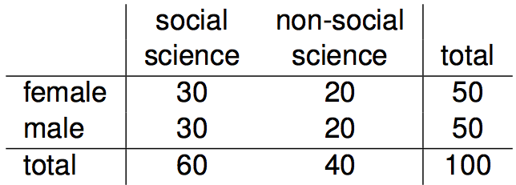
Independence and
conditional probabilities
Consider the following (hypothetical) distribution of gender and major of students in an introductory statistics class:

Slide 28
Independence and
conditional probabilities
Consider the following (hypothetical) distribution of gender and major of students in an introductory statistics class:
The probability that a randomly selected student is a social science major is

Slide 29
Independence and
conditional probabilities
Consider the following (hypothetical) distribution of gender and major of students in an introductory statistics class:
The probability that a randomly selected student is a social science major is
60 / 100 = 0.6.

Slide 30
Independence and
conditional probabilities
Consider the following (hypothetical) distribution of gender and major of students in an introductory statistics class:
The probability that a randomly selected student is a social science major is
60 / 100 = 0.6.
The probability that a randomly selected student is a social science major given that they are female is

Slide 31
Independence and
conditional probabilities
Consider the following (hypothetical) distribution of gender and major of students in an introductory statistics class:
The probability that a randomly selected student is a social science major is
60 / 100 = 0.6.
The probability that a randomly selected student is a social science major given that they are female is
30 / 50 = 0.6.

Slide 32
Independence and
conditional probabilities
Consider the following (hypothetical) distribution of gender and major of students in an introductory statistics class:
The probability that a randomly selected student is a social science major is
60 / 100 = 0.6.
The probability that a randomly selected student is a social science major given that they are female is
30 / 50 = 0.6.
Since P(SS | M) also equals 0.6, major of students in this class does not depend on their gender: P(SS | F) = P(SS).

Slide 33
Independence and
conditional probabilities (cont.)
Generically, if P(A | B) = P(A) then the events A and B are said to be independent.

Slide 34
Independence and
conditional probabilities (cont.)
Generically, if P(A | B) = P(A) then the events A and B are said to be independent.
Conceptually: Giving B doesn’t tell us anything about A.

Slide 35

Independence and
conditional probabilities (cont.)
Generically, if P(A | B) = P(A) then the events A and B are said to be independent.
Conceptually: Giving B doesn’t tell us anything about A.
Mathematically: We know that if events A and B are independent, P(A and B) = P(A) x P(B). Then,

Slide 36



General multiplication rule for more than 2 variables - example
S
Assume that half of the population of interest is used to protracted Sun exposures.
Only 90% among them uses solar Cream.
The risk of developing Melanoma, for people used to protracted solar exposure but using sun protection is 2.6%
What is the probability that a randomly selected person in the population is used to protracted solar exposure, uses solar cream and has developed skin cancer?
C
M

Slide 37
General multiplication rule for more than 2 variables - example
S
Assume that half of the population of interest is used to protracted Sun exposures.
Only 90% among them uses solar Cream.
The risk of developing Melanoma, for people used to protracted solar exposure but using sun protection is 2.6%
What is the probability that a randomly selected person in the population is used to protracted solar exposure, uses solar cream and has developed skin cancer?
C
M
Protracted sun exposure Cream Melanoma Joint probabilities
S C M
Yes
0.5
No
0.5
Yes
0.9
No
0.1
Yes
No
Yes
0.026
No
0.974
Yes
No
Yes
No
Yes
No
P(S=Yes ∩ C=Yes ∩ M= Yes) = 0.5 * 0.9 * 0.026 = 0.0117
Marginal probability of Protracted sun exposure
P(S = Yes)
Conditional probability of using cream when used to protracted sun exposure
P(C=Yes | S =Yes)
Conditional probability of melanoma when used to protracted sun exposure using cream
P(M=Yes | S =Yes ∩ C= Yes)
NOTE: This example also shows how tree diagrams can be useful to deal with conditional probabilities.

Slide 38
General multiplication rule for more than 2 variables - example
S
Assume that half of the population of interest is used to protracted Sun exposures.
Only 90% among them uses solar Cream.
The risk of developing Melanoma, for people used to protracted solar exposure but using sun protection is 2.6%
What is the probability that a randomly selected person in the population is used to protracted solar exposure, uses solar cream and has developed skin cancer?
GENERAL MULTIPLICATION RULE OR FACTORIZATION
P(S=Yes ∩ C=Yes ∩ M= Yes) = P(S=Yes) P(C=Yes | S =Yes) P(M=Yes | S =Yes ∩ C= Yes)
=P(S=Yes ∩ C=Yes)
C
M

Slide 39
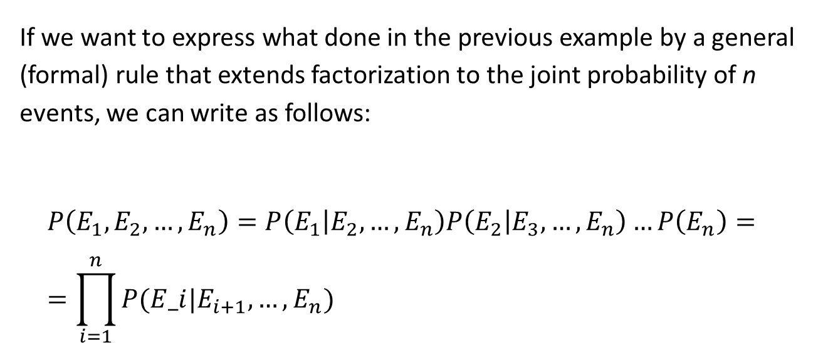
General multiplication rule for more than 2 variables
If we want to express what done in the previous example by a general (formal) rule that extends factorization to the joint probability of n events, we can write as follows:
$$P\left(E_{1}, E_{2},…, E_{n}\right)=P\left(E_{1} | E_{2},…, E_{n}\right)P\left(E_{2} | E_{3},…, E_{n}\right)…P\left(E_{n}\right)= \\ =\prod_{i=1}^{n}{P(E_i|E_{i+1}, …, E_{n})}$$

Slide 40
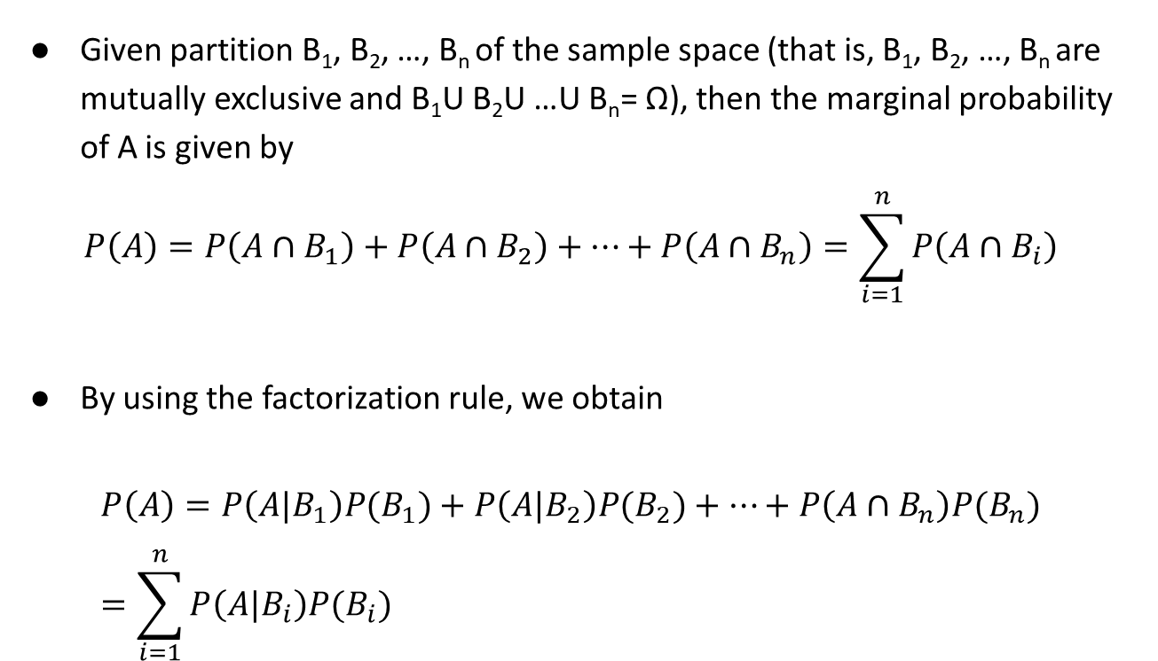
Law of total probability
Given partition B₁, B₂, …, B_{n} of the sample space (that is, B₁, B₂, …, B_{n} are mutually exclusive and B₁U B₂U …U B_{n}= Ω), then the marginal probability of A is given by
$$P\left(A\right)=P\left(A∩B_{1}\right)+P\left(A∩B_{2}\right)+…+P\left(A∩B_{n}\right)=\sum_{i=1}^{n}{P\left(A∩B_{i}\right)}$$
By using the factorization rule, we obtain
$$P\left(A\right)=P\left(A|B_{1}\right)P(B_{1})+P\left(A|B_{2}\right)P(B_{2})+…+P\left(A∩B_{n}\right)P(B_{n})=\sum_{i=1}^{n}{P\left(A|B_{i}\right)P(B_{i})}$$

Slide 41
Bayes theorem

Slide 42
Inverting probabilities
When a patient goes through breast cancer screening there are two competing claims: patient had cancer and patient doesn't have cancer. If a mammogram yields a positive result, what is the probability that patient actually has cancer?

Slide 43
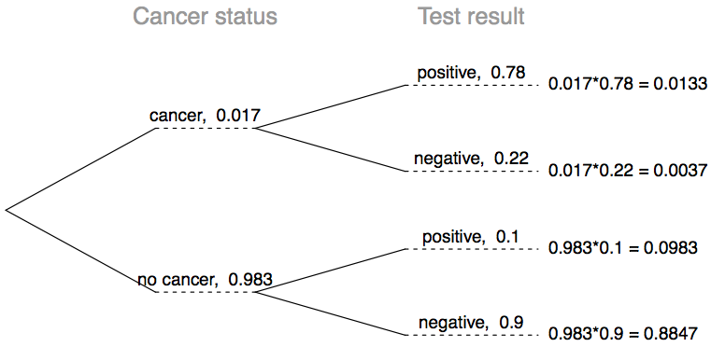
Inverting probabilities
When a patient goes through breast cancer screening there are two competing claims: patient had cancer and patient doesn't have cancer. If a mammogram yields a positive result, what is the probability that patient actually has cancer?

Slide 44




Inverting probabilities
When a patient goes through breast cancer screening there are two competing claims: patient had cancer and patient doesn't have cancer. If a mammogram yields a positive result, what is the probability that patient actually has cancer?

Slide 45
Inverting probabilities
When a patient goes through breast cancer screening there are two competing claims: patient had cancer and patient doesn't have cancer. If a mammogram yields a positive result, what is the probability that patient actually has cancer?

Slide 46
Reference for the breast cancer screening example
American Cancer Society estimates that about 1.7% of women have breast cancer. http://www.cancer.org/cancer/cancerbasics/cancer-prevalence
Susan G. Komen For The Cure Foundation states that mammography correctly identifies about 78% of women who truly have breast cancer. http://ww5.komen.org/BreastCancer/AccuracyofMammograms.html
An article published in 2003 suggests that up to 10% of all mammograms result in false positives for patients who do not have cancer. http://www.ncbi.nlm.nih.gov/pmc/articles/PMC1360940
Note: These percentages are approximate, and very difficult to estimate.

Slide 47
Practice
Suppose a woman who gets tested once and obtains a positive result wants to get tested again. In the second test, what should we assume to be the probability of this specific woman having cancer?
(a) 0.017
(b) 0.12
(c) 0.0133
(d) 0.88

Slide 48
Practice
Suppose a woman who gets tested once and obtains a positive result wants to get tested again. In the second test, what should we assume to be the probability of this specific woman having cancer?
(a) 0.017
(b) 0.12
(c) 0.0133
(d) 0.88

Slide 49
Practice
What is the probability that this woman has cancer if this second mammogram also yielded a positive result?
(a) 0.0936
(b) 0.088
(c) 0.48
(d) 0.52

Slide 50
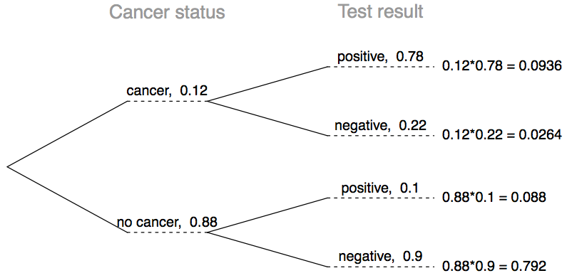
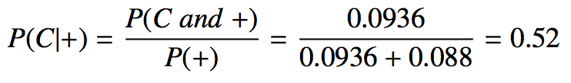
Practice
What is the probability that this woman has cancer if this second mammogram also yielded a positive result?
(a) 0.0936
(b) 0.088
(c) 0.48
(d) 0.52

Slide 51


Law of total probability
In the breast cancer example we have used the law of total probability
Where we have factorized P(C∩+) and P(ᆨC∩+):
This is the general expression of the law of total probability:

Slide 52

Bayes' Theorem
In the breast cancer example we have computed P(C|+) from P(+|C) by applying the conditional probability formula
The factorization of P(C and +) = P(+|C)P(C)
And the law of total probability P(+)=P(+|C)P(C)+P(+|ㄱC)P(ㄱC)
Putting all this together, we obtain the Bayes rule:

Slide 53


Bayes' Theorem
We can generalize the Bayes' Theorem to variables with more than just two outcomes.
Let {A₁, A₂, ...., A_{m}} be all possible outcomes of A and {B₁, B₂, ...., B_{n}} all possible outcomes of B
with

Slide 54
Application activity:
inverting probabilities
A common epidemiological model for the spread of diseases is the SIR model, where the population is partitioned into three groups: Susceptible, Infected, and Recovered. This is a reasonable model for diseases like chickenpox where a single infection usually provides immunity to subsequent infections. Sometimes these diseases can also be difficult to detect.
Imagine a population in the midst of an epidemic where 60% of the population is considered susceptible, 10% is infected, and 30% is recovered. The only test for the disease is accurate 95% of the time for susceptible individuals, 99% for infected individuals, but 65% for recovered individuals. (Note: In this case accurate means returning a negative result for susceptible and recovered individuals and a positive result for infected individuals).
Draw a probability tree to reflect the information given above. If the individual has tested positive, what is the probability that they are actually infected?

Slide 55
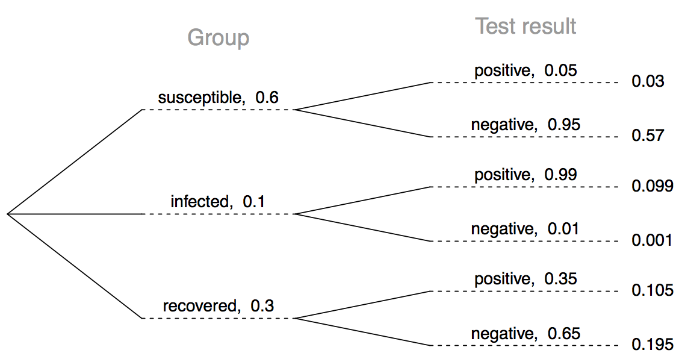
Application activity:
inverting probabilities (cont.)

Slide 56

Application activity:
inverting probabilities (cont.)

